Slide 1



Figure 1
Metamonada
Opisthokonta
Amoebozoa
Discoba
Rhizaria
Streptophyta
Alveolata
Stramenopila
Rhodophyta
Chlorophyta

Slide 2
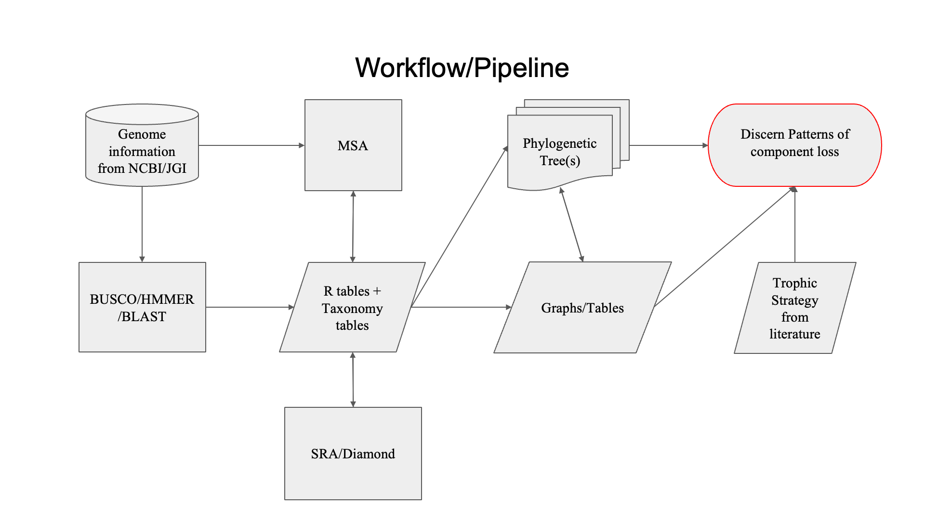
Figure 1

Slide 3





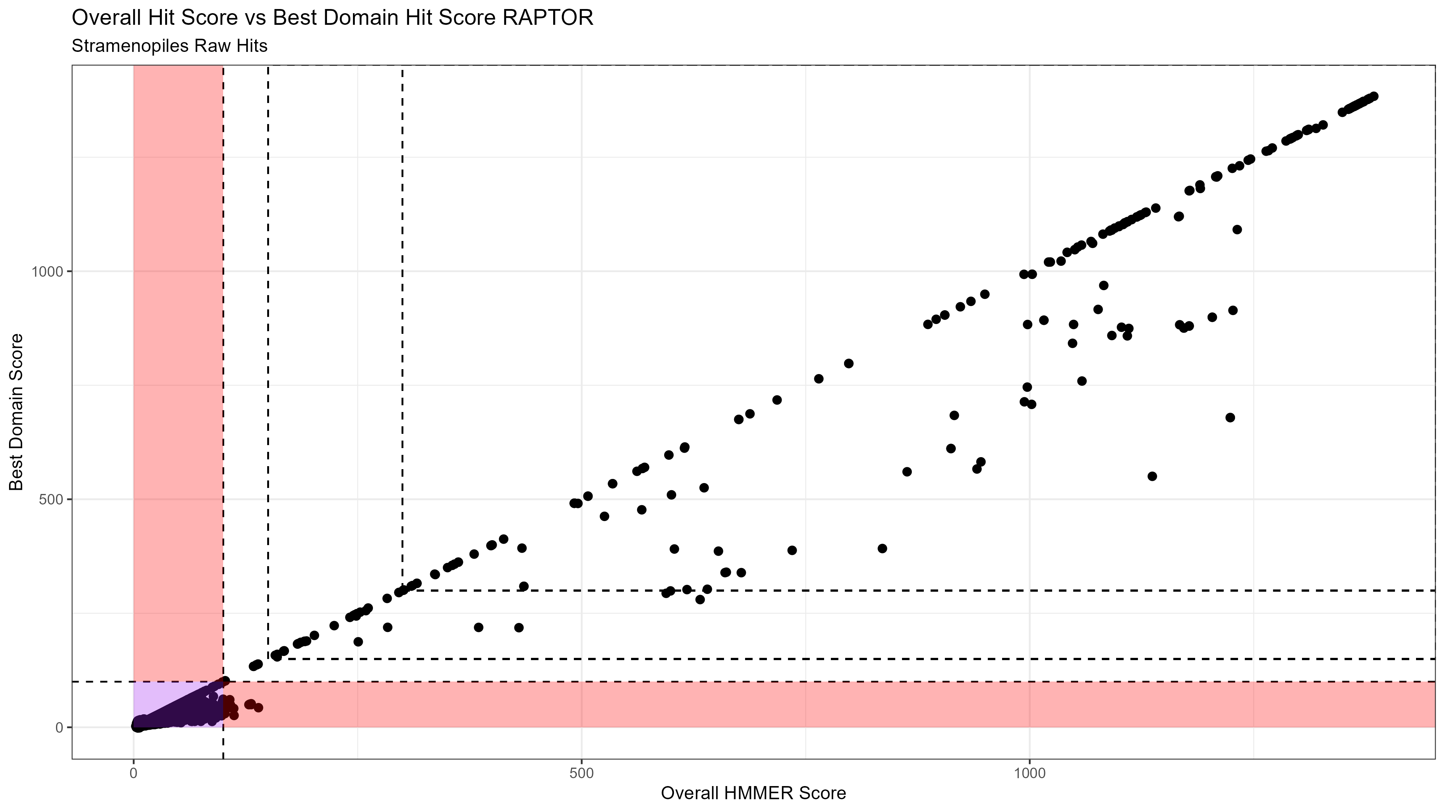


Figure 2

Slide 4
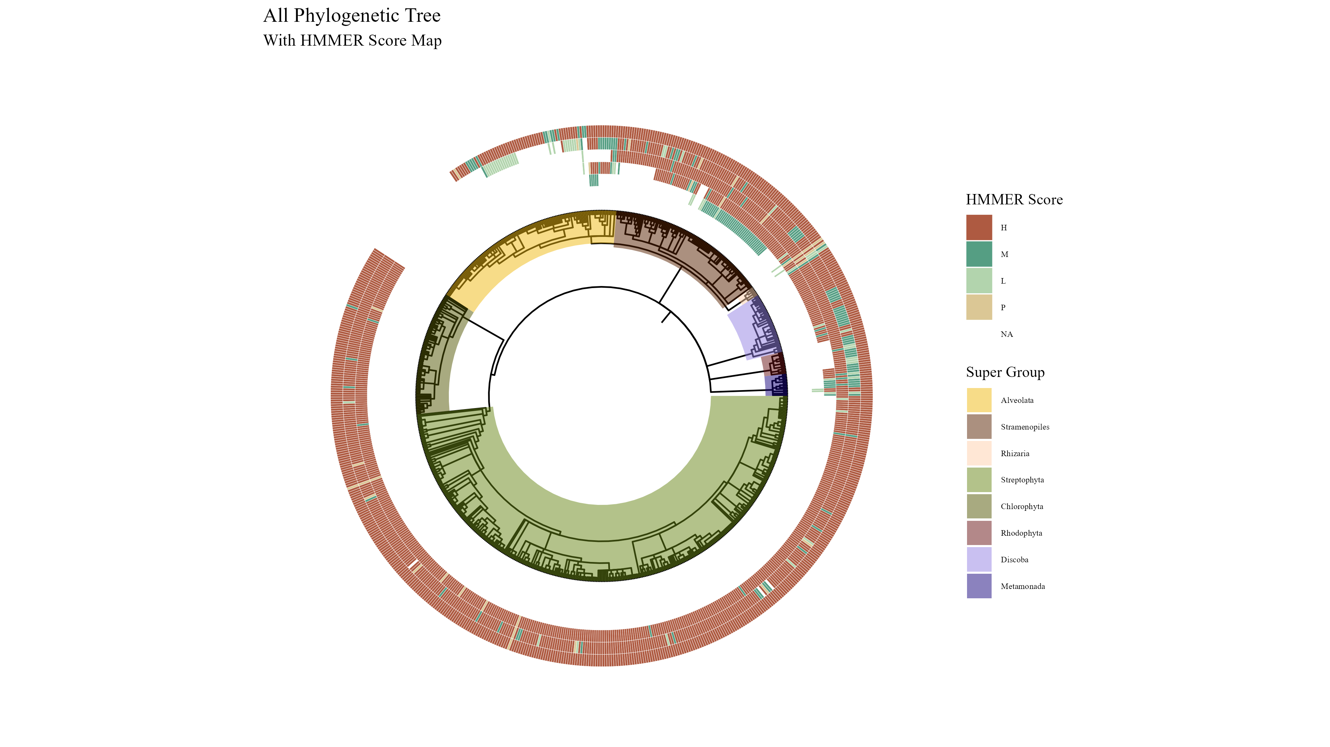
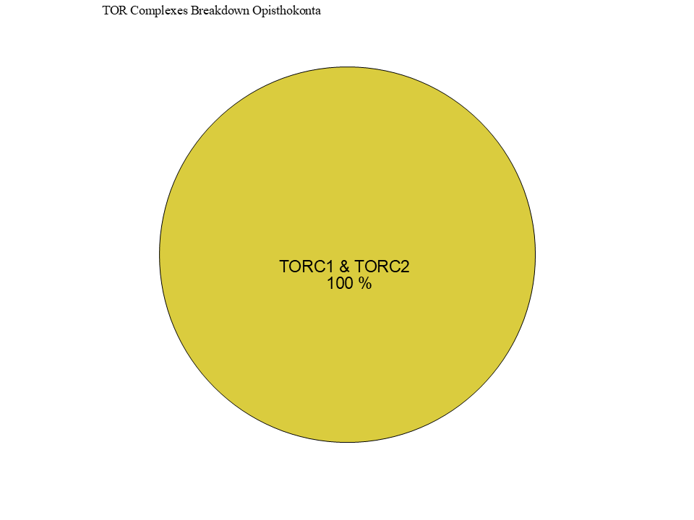
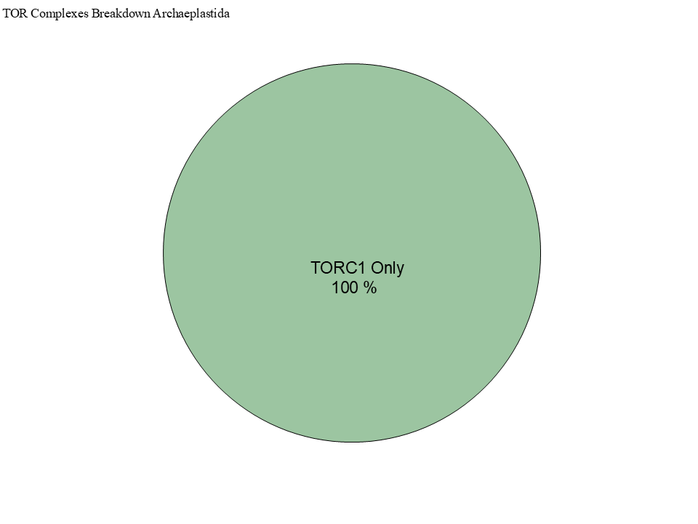
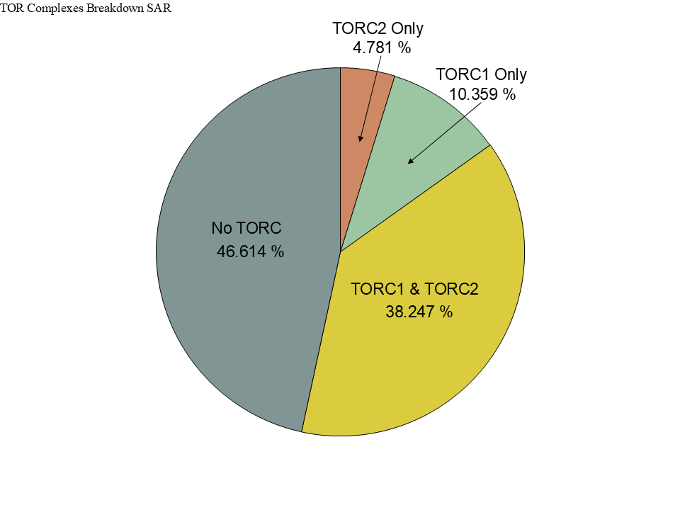
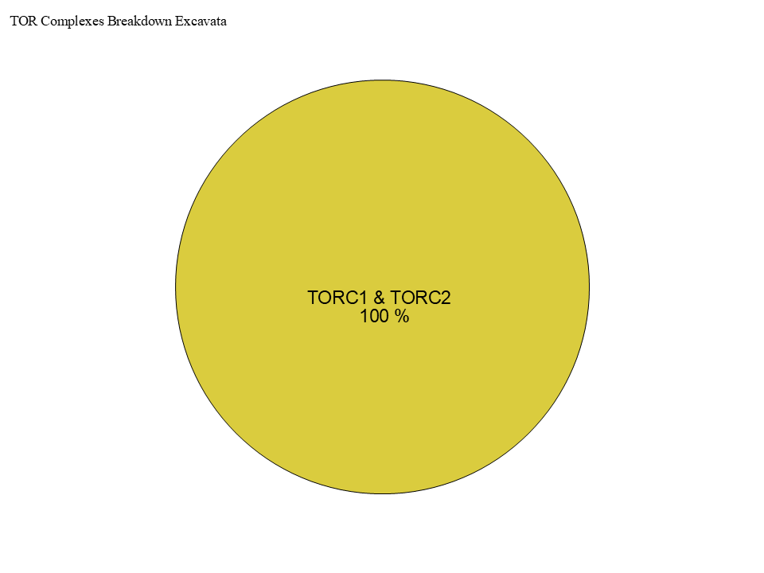
Figure 3
TOR
LST8
RAPTOR
RICTOR
SIN1

Slide 5
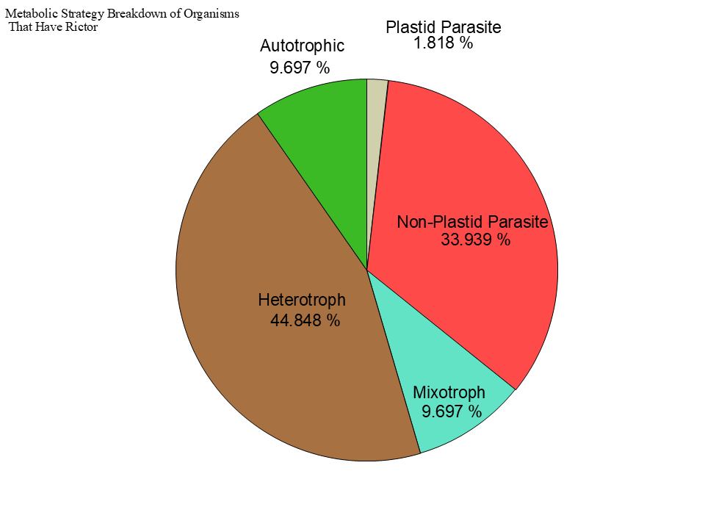
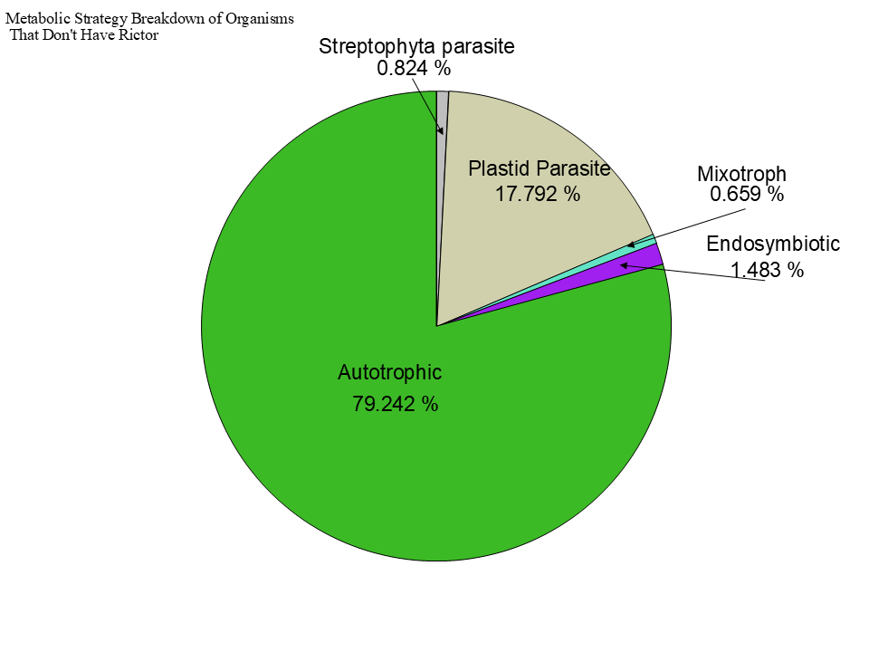
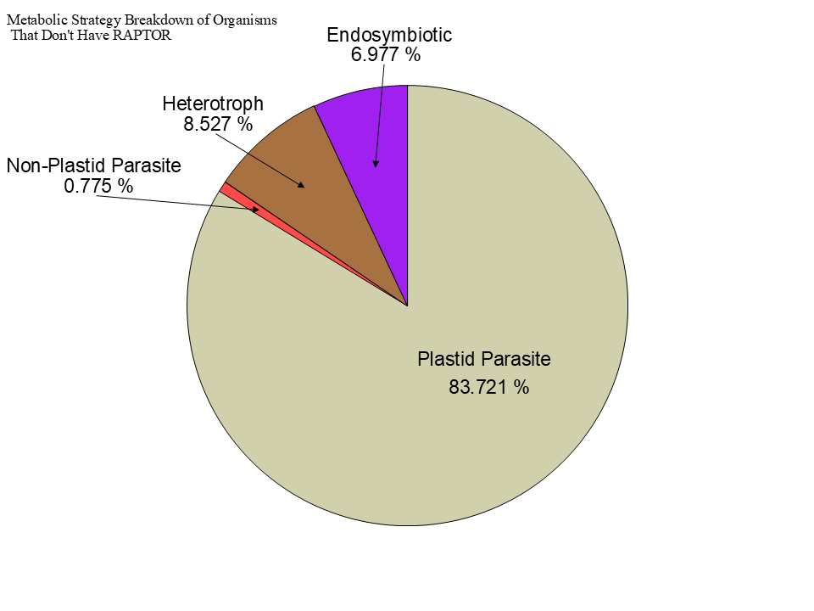
Figure 3

Slide 6
Streptophyta
Secondary Endosymbiosis
Rhodophyta
Primary Endosymbiosis
TORC2
Chlorophyta
Chlorarachniales
TORC1 + TORC2
Rhizaria
TORC1 + TORC2
Primary Endosymbiosis
Archaeplastida
TORC1
LECA
TORC1 + TORC2
Paulinella Micropora
TORC1 + TORC2
SAR
TORC1 +TORC2
Secondary Endosymbiosis
TORC2
Stramenopiles TORC1 + TORC2
Brown Algae
TORC1
Secondary Endosymbiosis
Excavates
TORC1 +TORC2
Tertiary Endosymbiosis
TORC2 + TORC1
Eulena Gracilis
TORC1 + TORC2
Alveolata

Slide 7
Secondary Endosymbiosis
Chlorarachniales
TORC1 + TORC2
Rhizaria
TORC1 + TORC2
TORC2
Paulinella Micropora
TORC1 + TORC2
Primary Endosymbiosis
Archaeplastida
TORC1
Primary Endosymbiosis
LECA
TORC1 + TORC2
TORC2
Bacillariophyta
TORC1
SAR
TORC1 +TORC2
Secondary Endosymbiosis
Brown Algae
TORC1 + TORC2
Stramenopiles TORC1 + TORC2
Microalgae
TORC1 + TORC2
Secondary Endosymbiosis
Excavates
TORC1 +TORC2
Eulena Gracilis
TORC1 + TORC2
Triparma
TORC1 + TORC2
TORC2 or TORC2 + TORC1
Ex. Polarella glaciallis
TORC1
Tertiary Endosymbiosis
Alveolata
Ex. Viterlla Brasicaformis
TORC1 + TORC2
Ex. Plasmodium Falidiparum

Slide 8




Figure 5

Slide 9
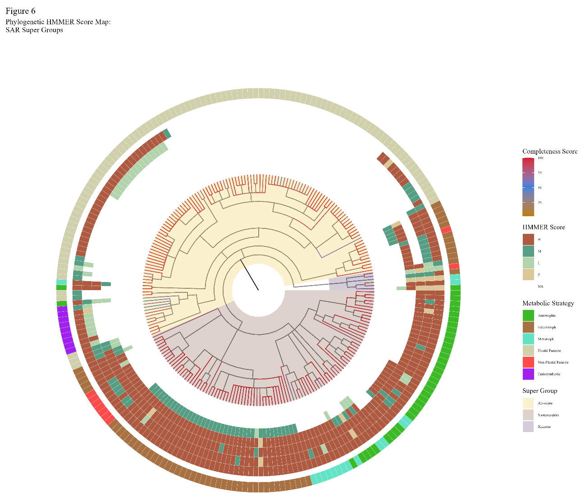
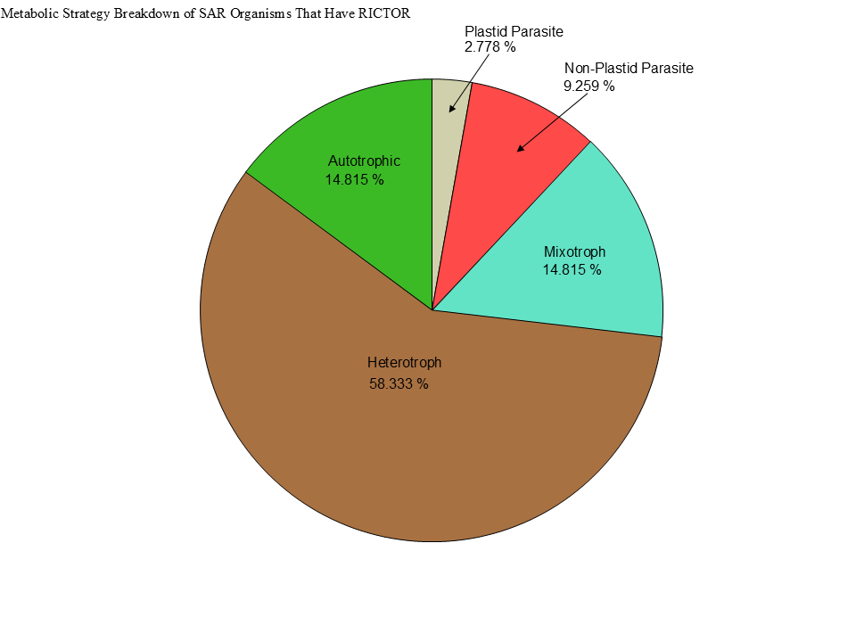
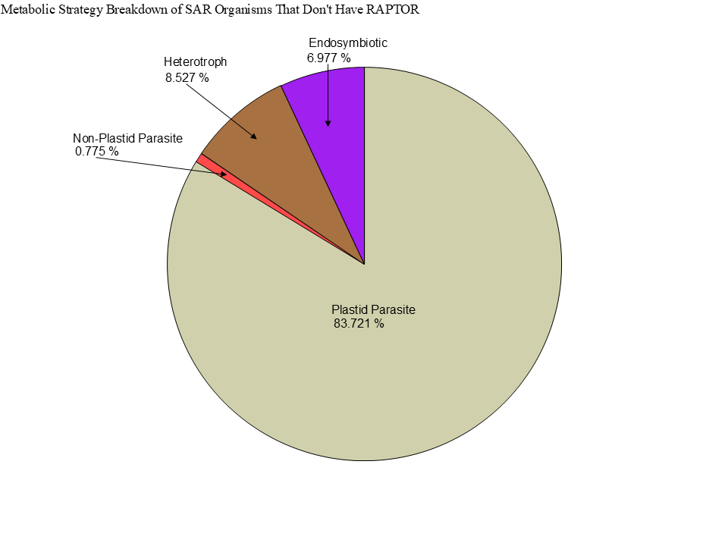
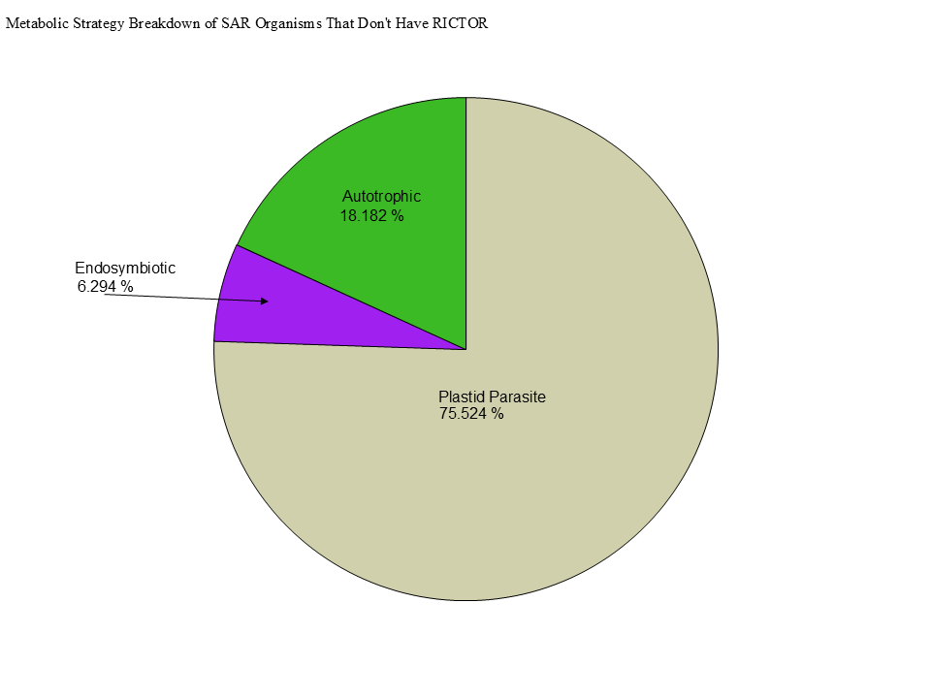

Slide 10
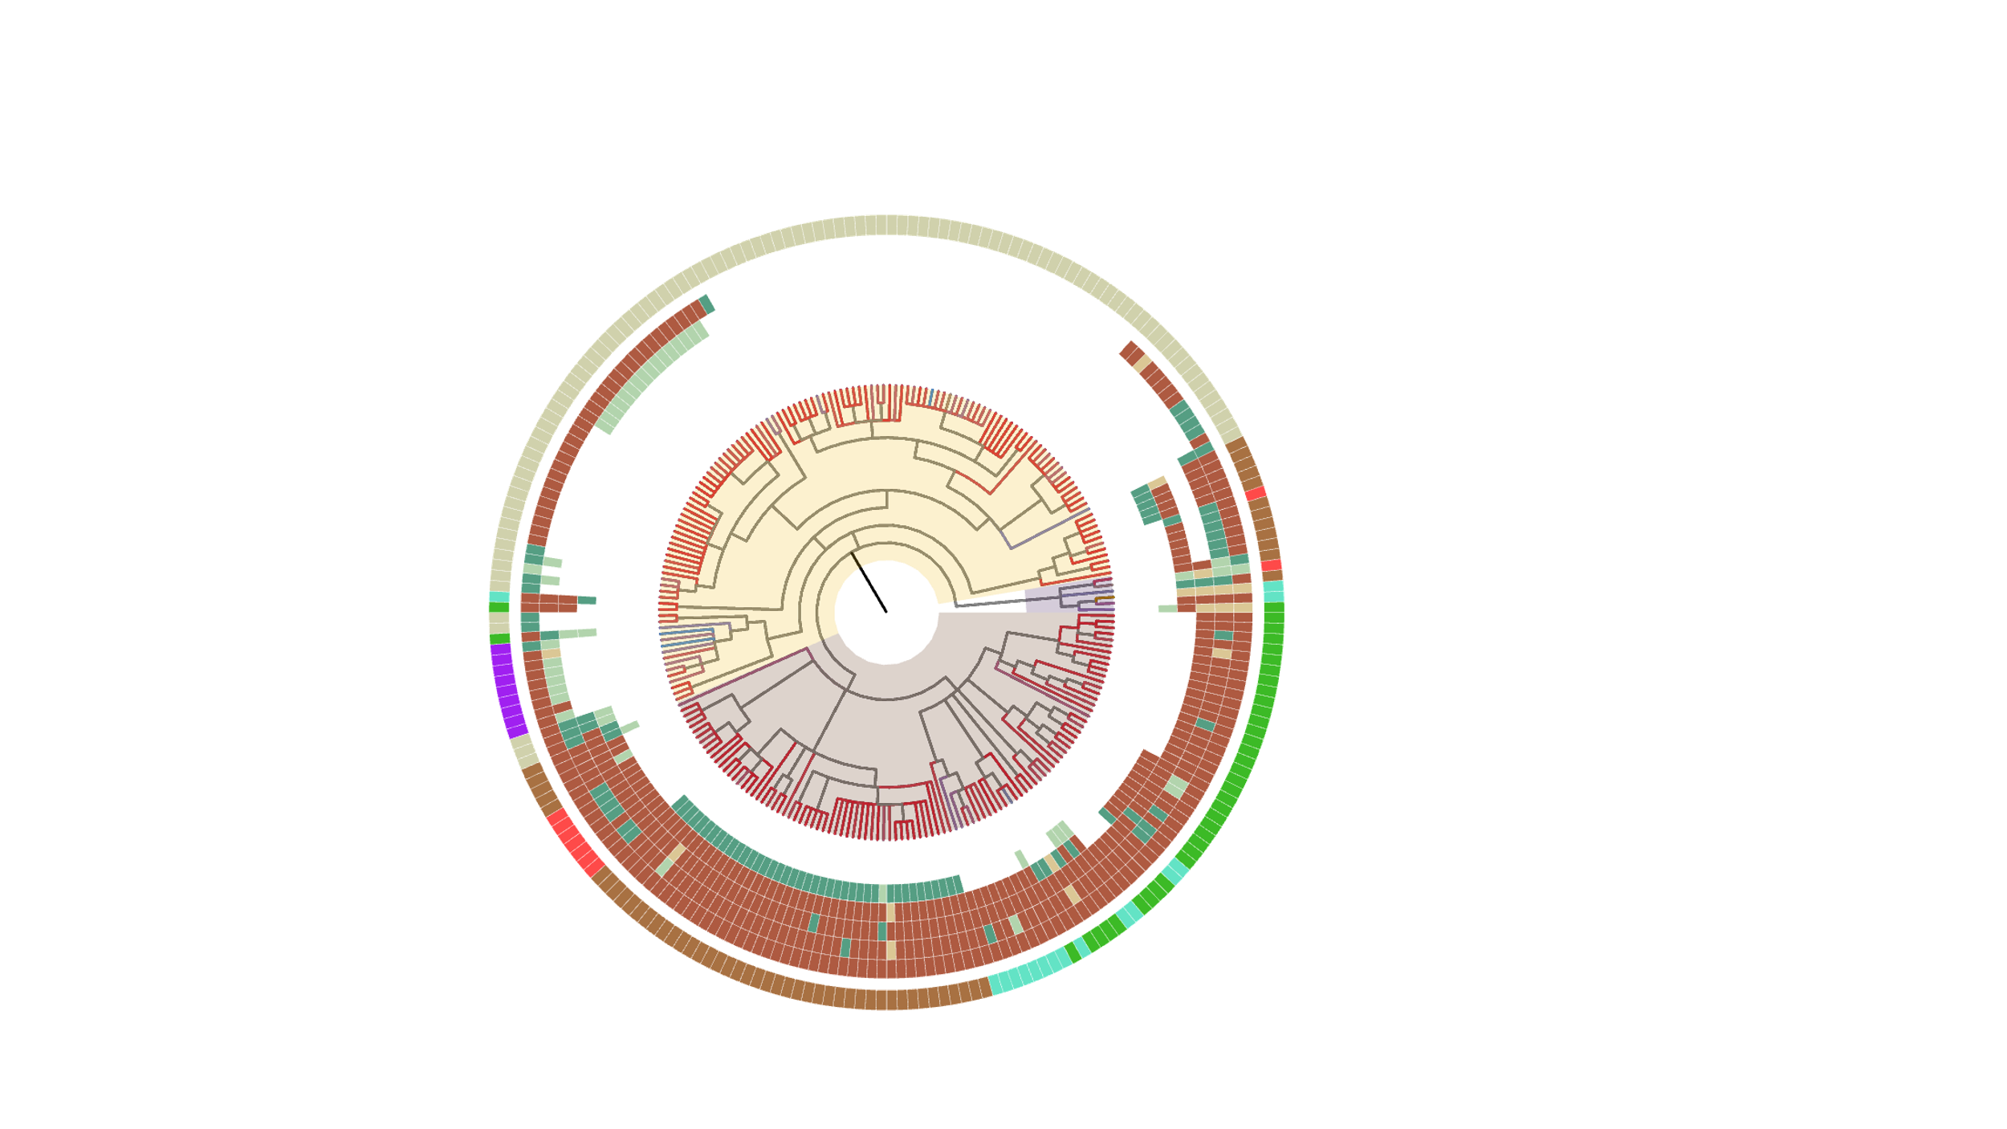
Ciliaphora
Chromera velia
Vitrella brassicaformis
Bacillariophyta
Phaeophyceae

Slide 11
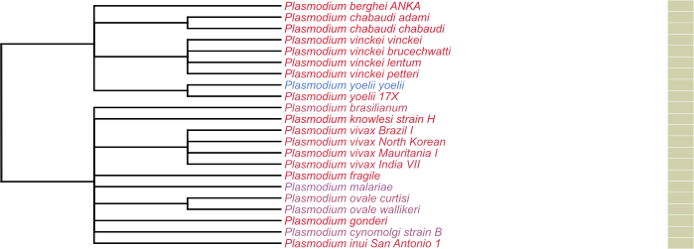
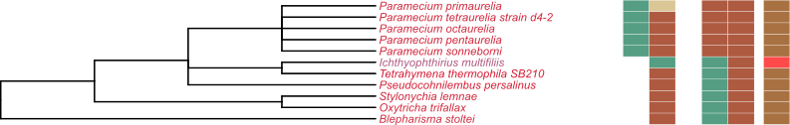
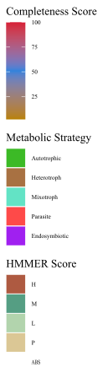
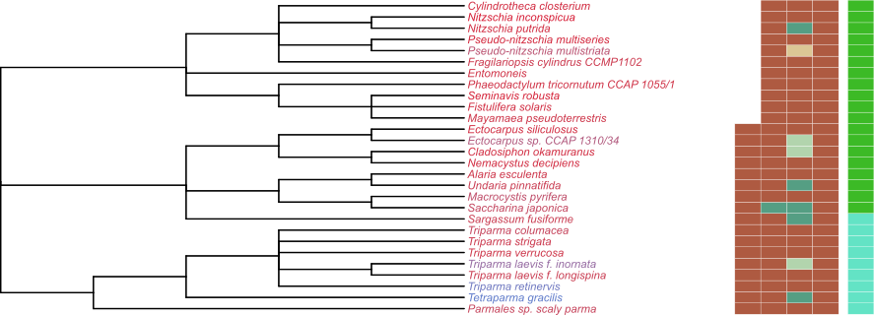
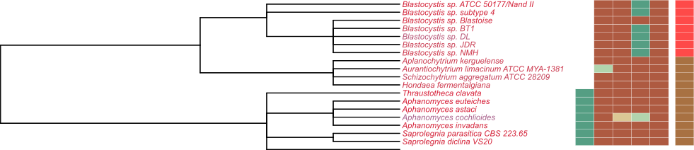

Slide 12

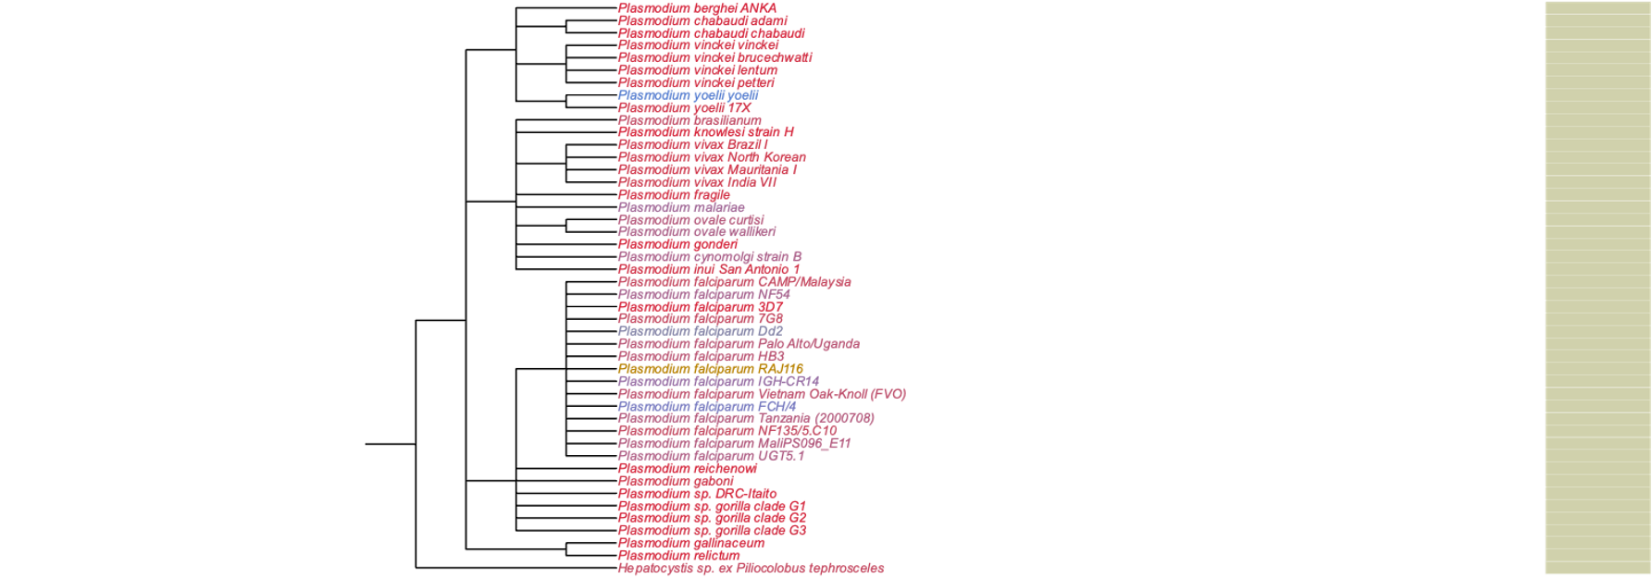
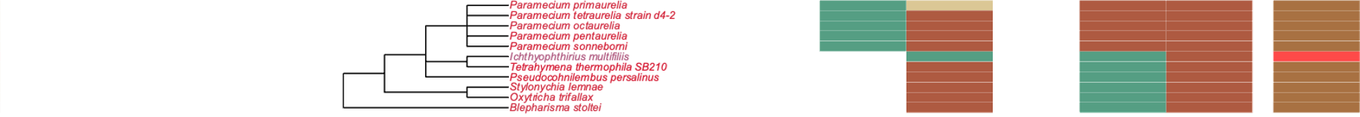
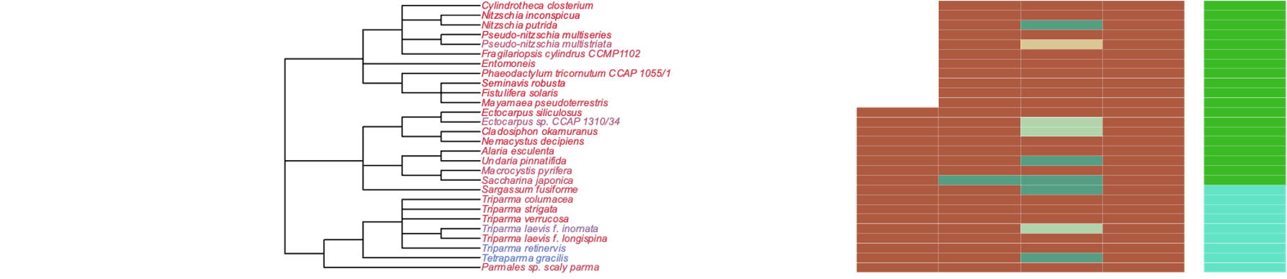
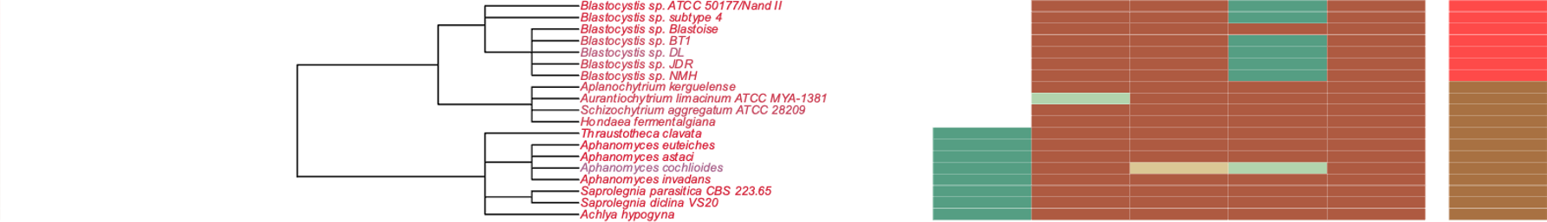
1
Plasmodiidae
2
Ciliophora
Bacillariophycidae
Phaeophyceae
Parmales
3
4
Bigyra
3
Saprolegniaceae

Slide 13
Bacillariophycidae
Phaeophyceae
Parmales
Plasmodiidae
Bigyra
Saprolegniaceae
Ciliophora

Slide 14
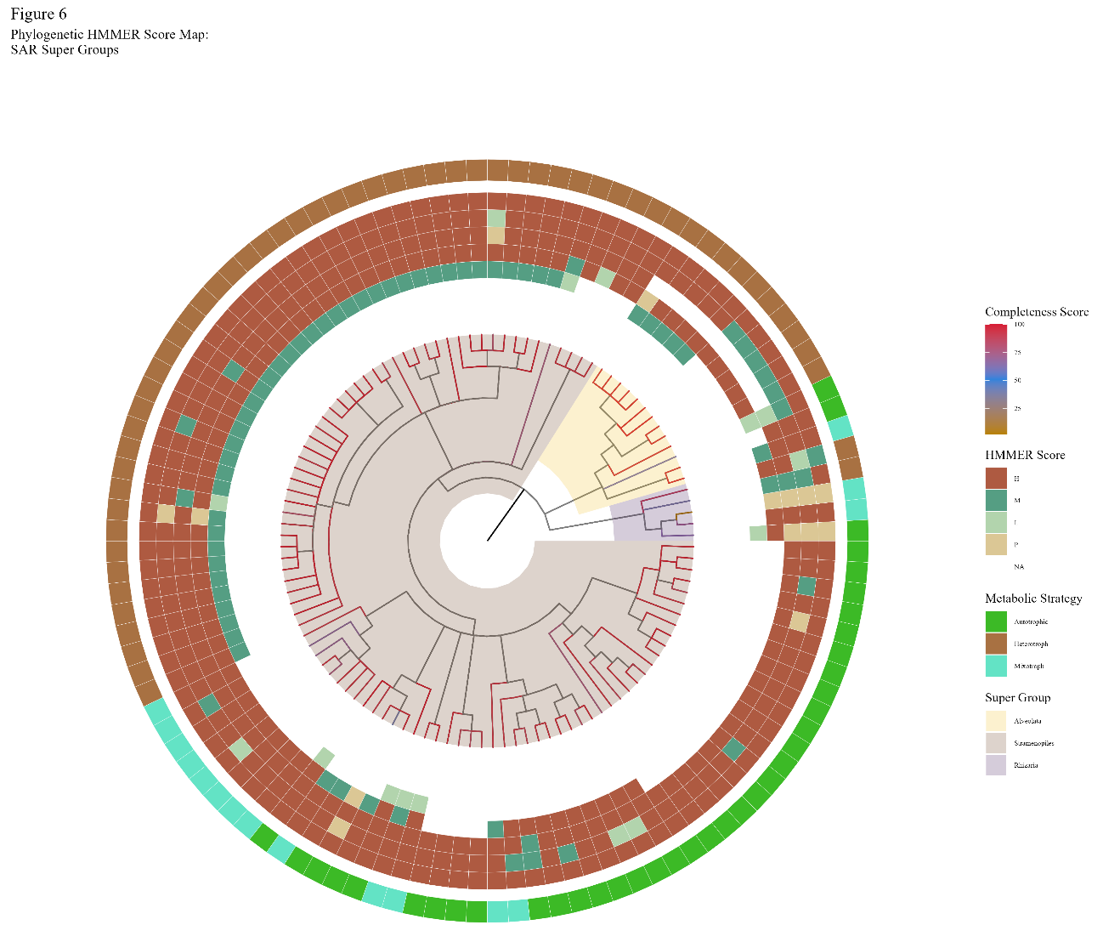
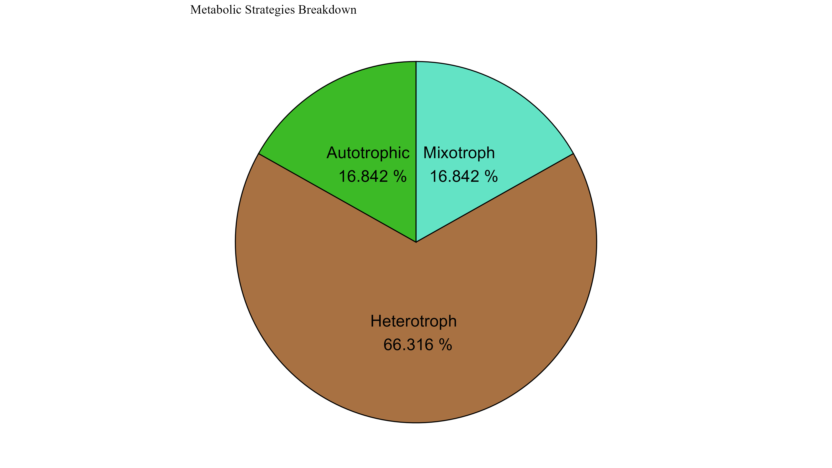
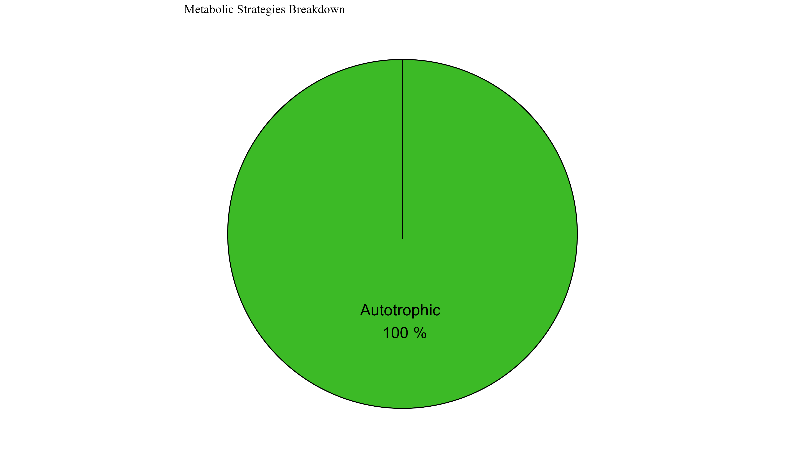

Slide 15
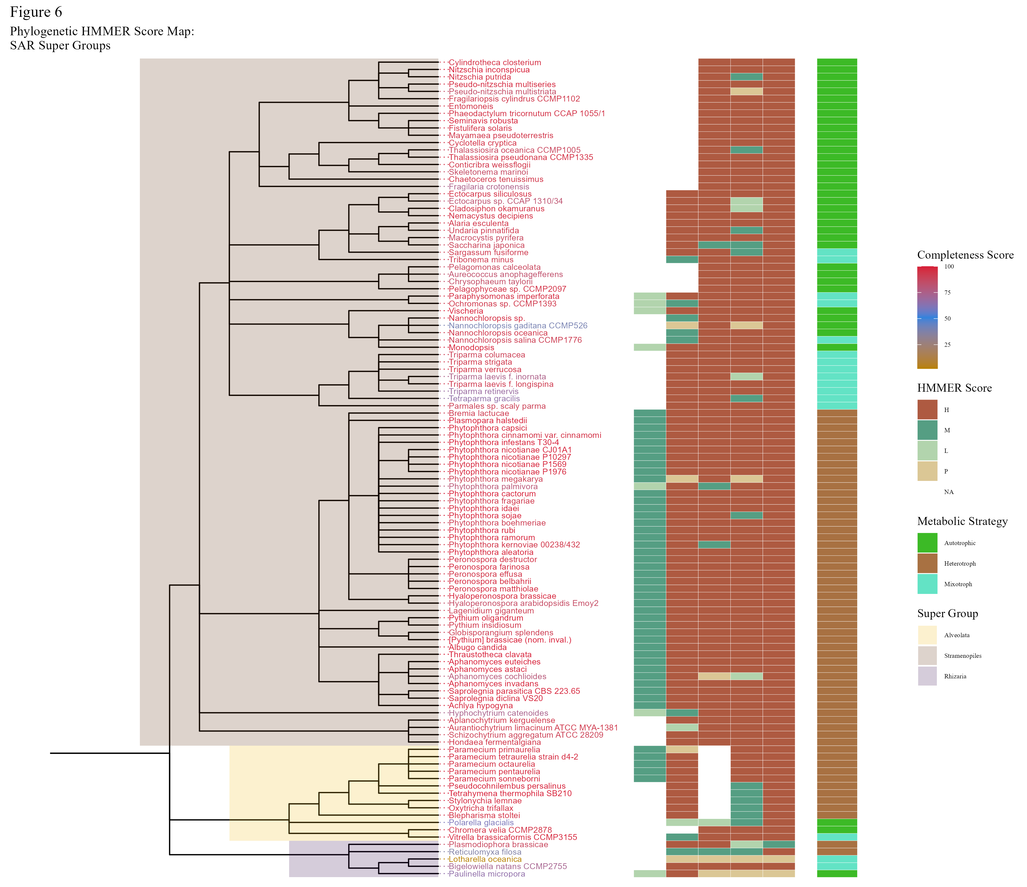

Slide 16
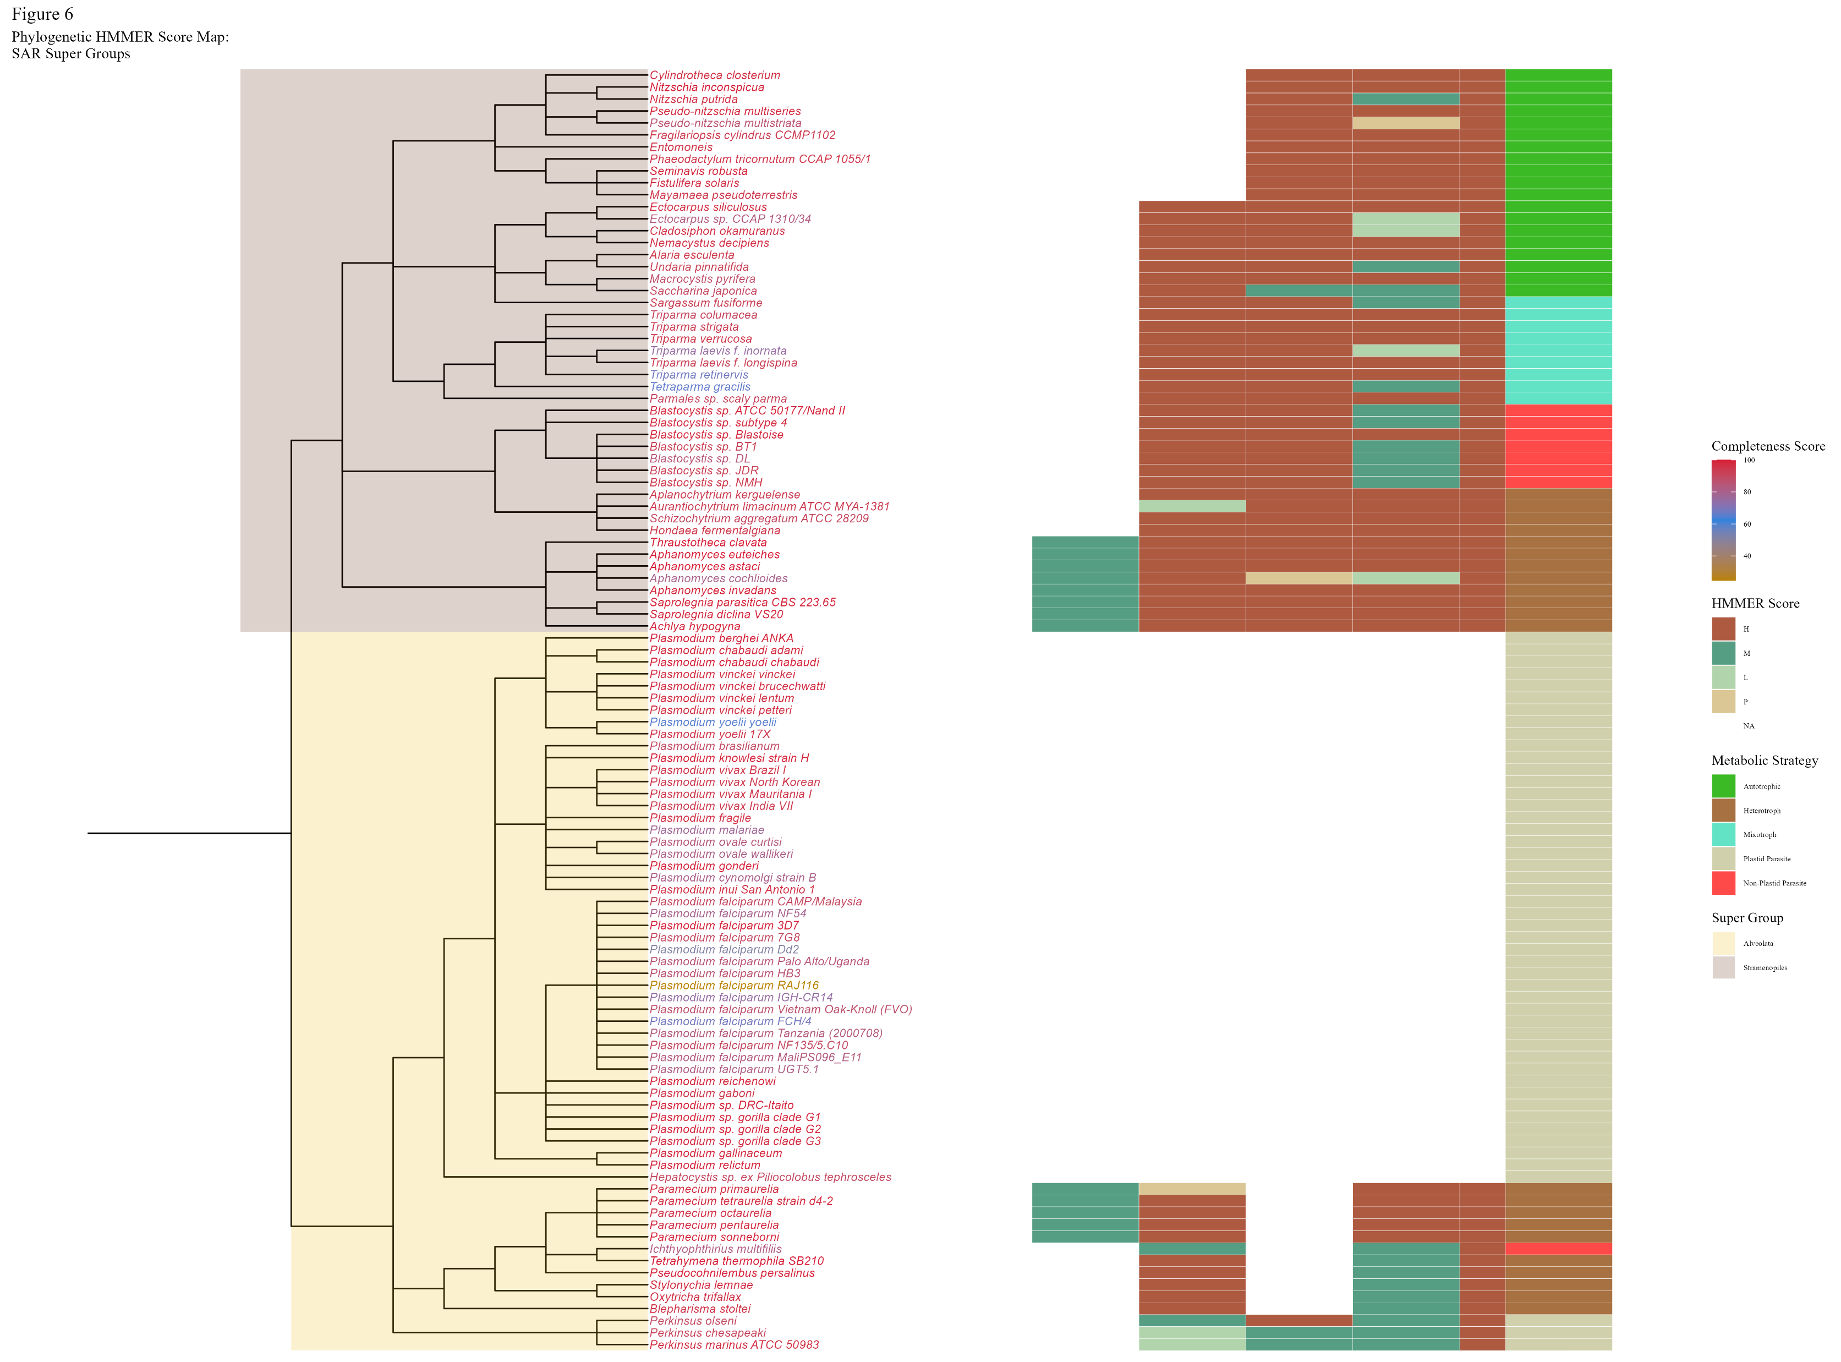

Slide 17
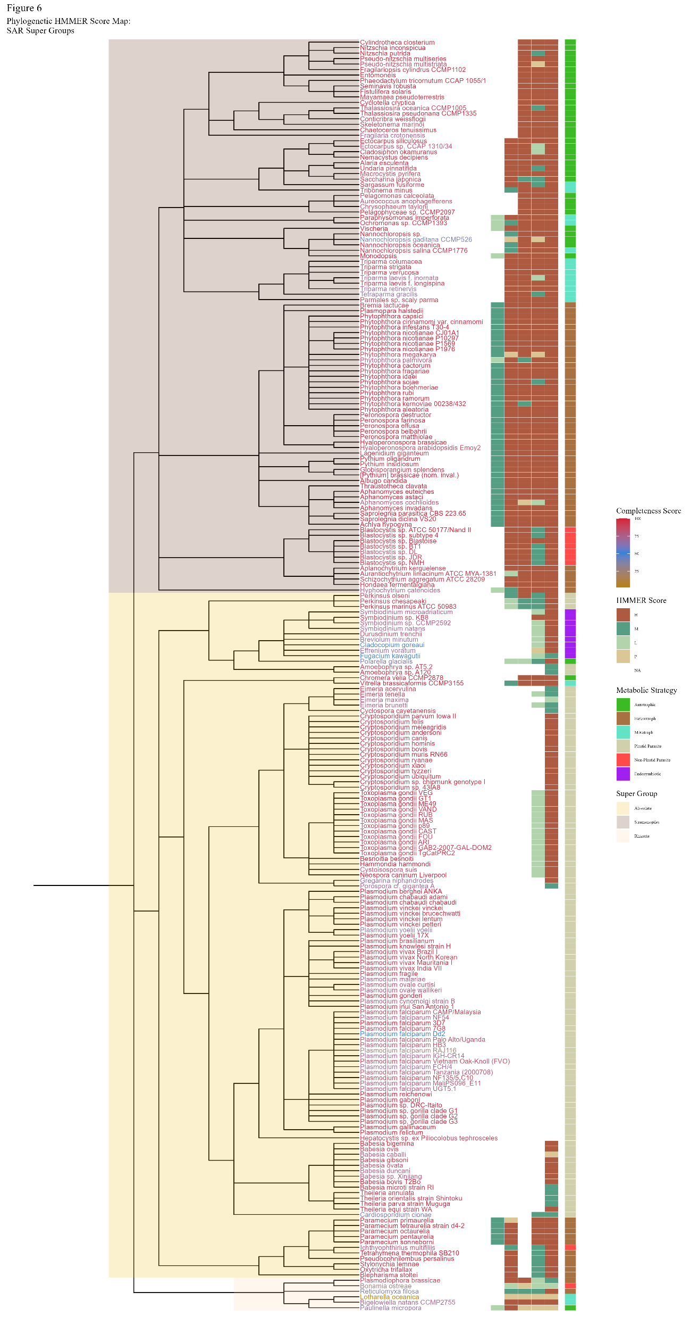

Slide 18
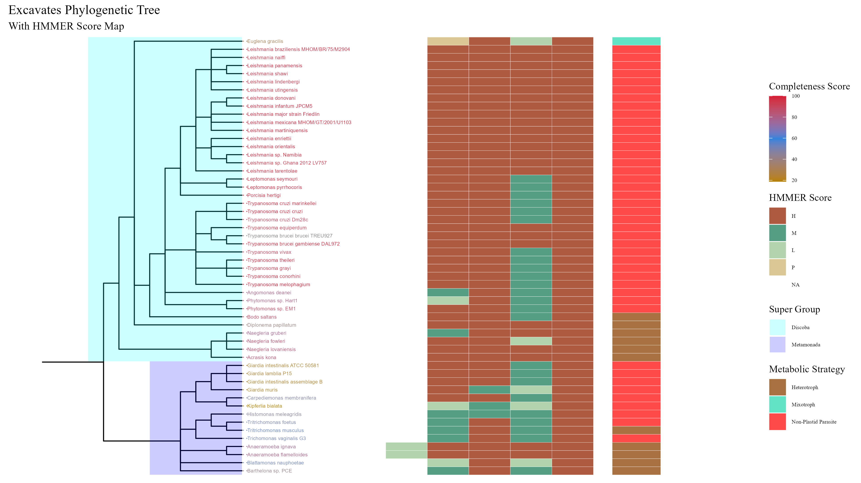

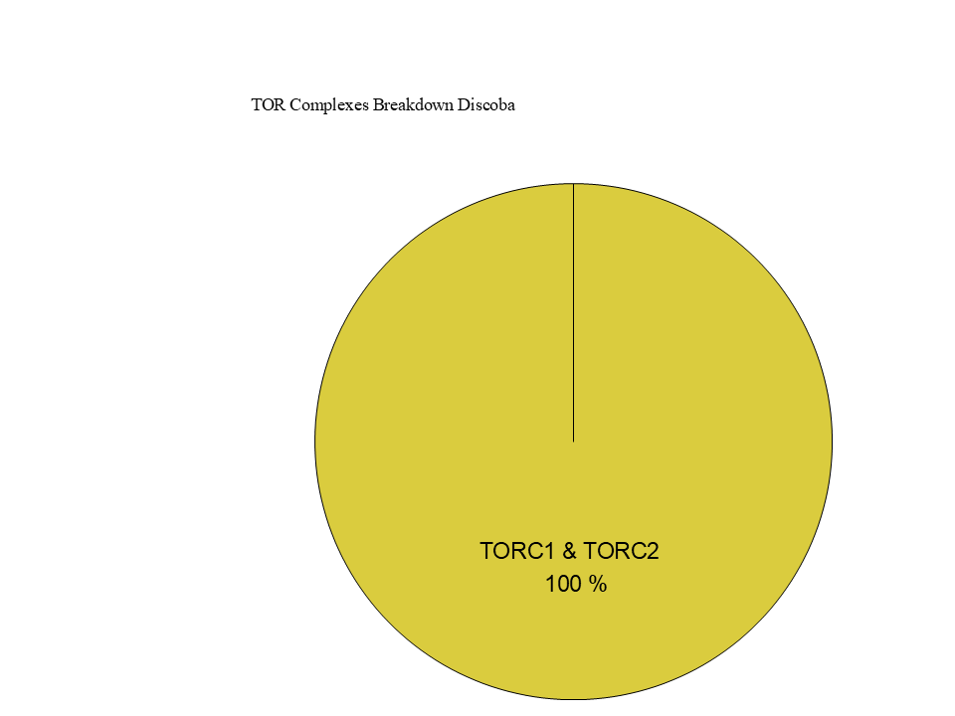
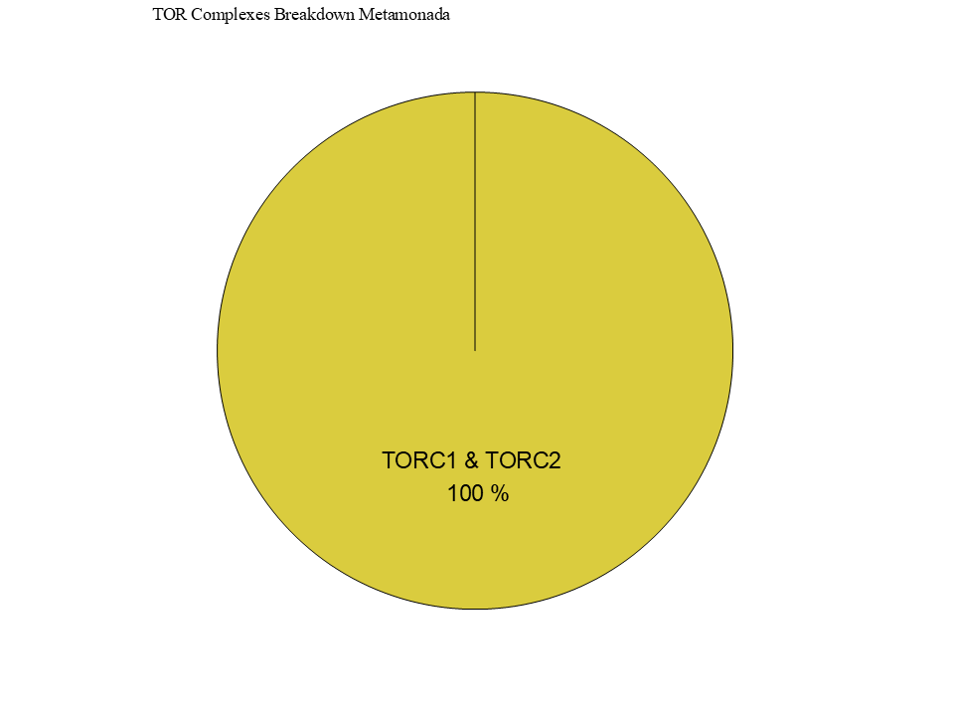
Figure 7

Slide 19

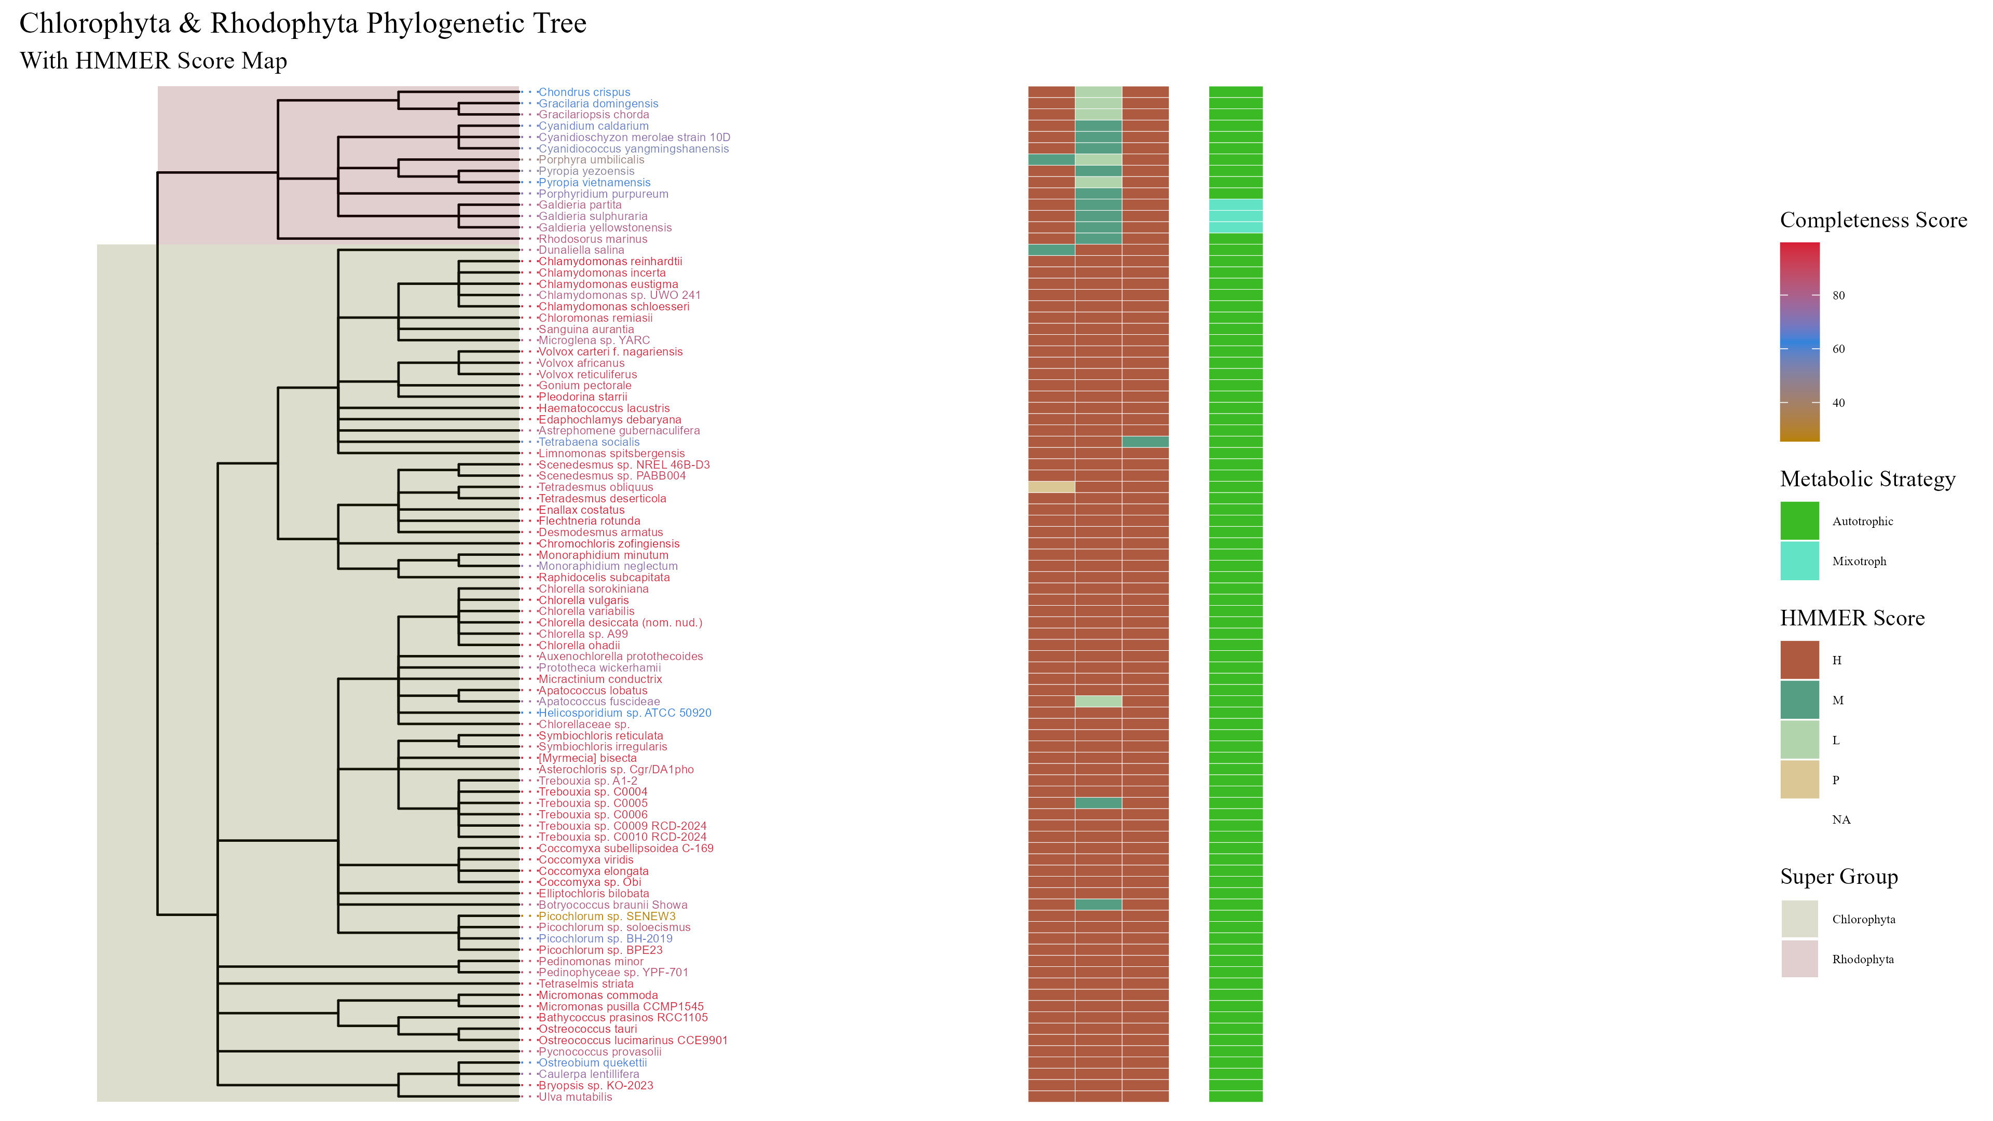
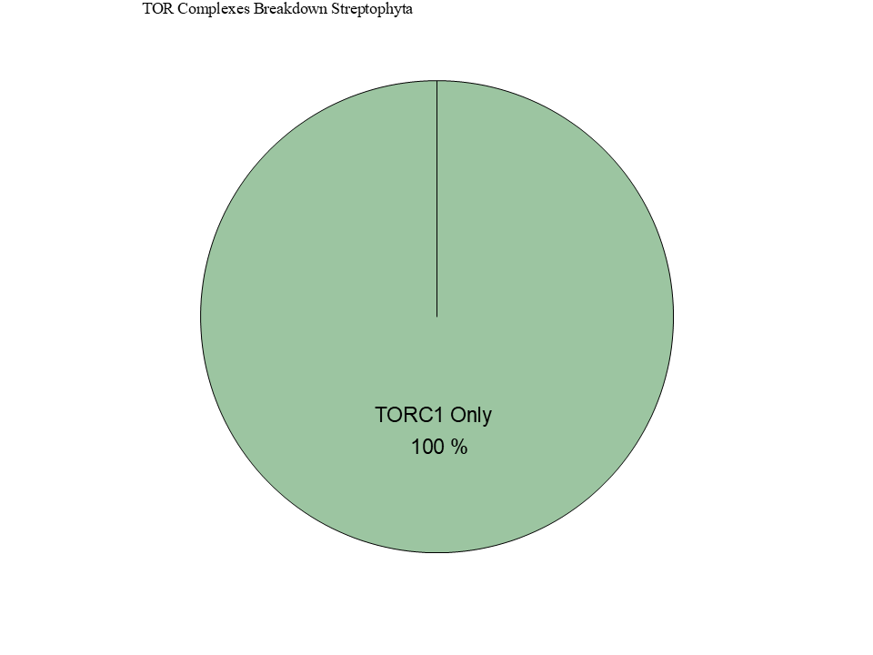
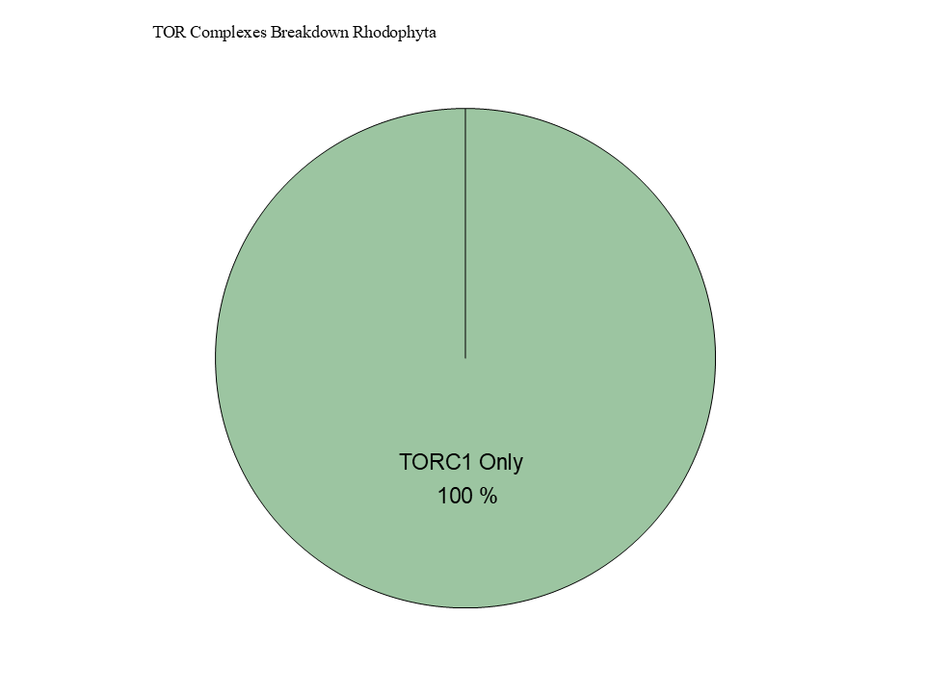

Slide 20
ARCHIVED BELOW

Slide 21


Slide 22





Figure 6

Slide 23
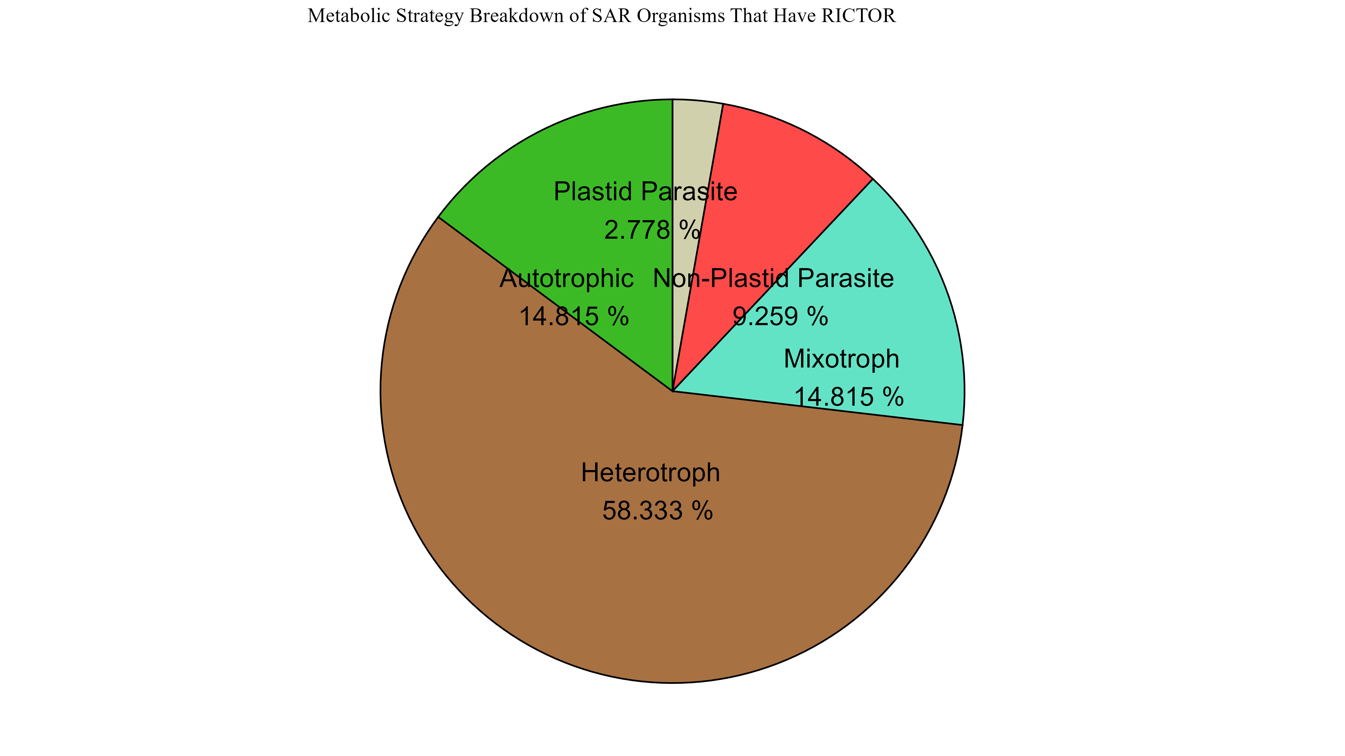
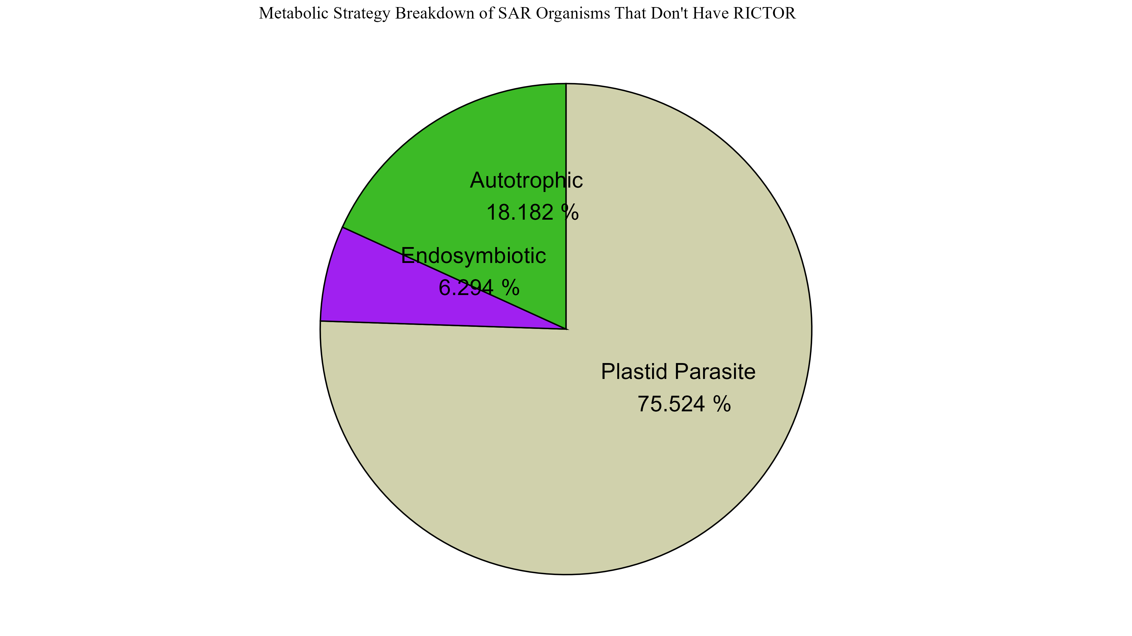
Figure 6

Slide 24
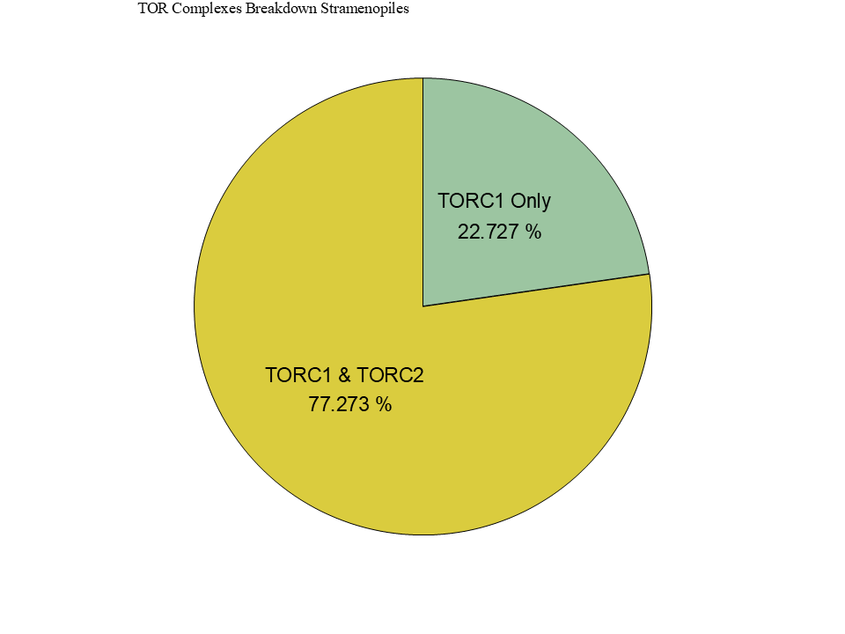
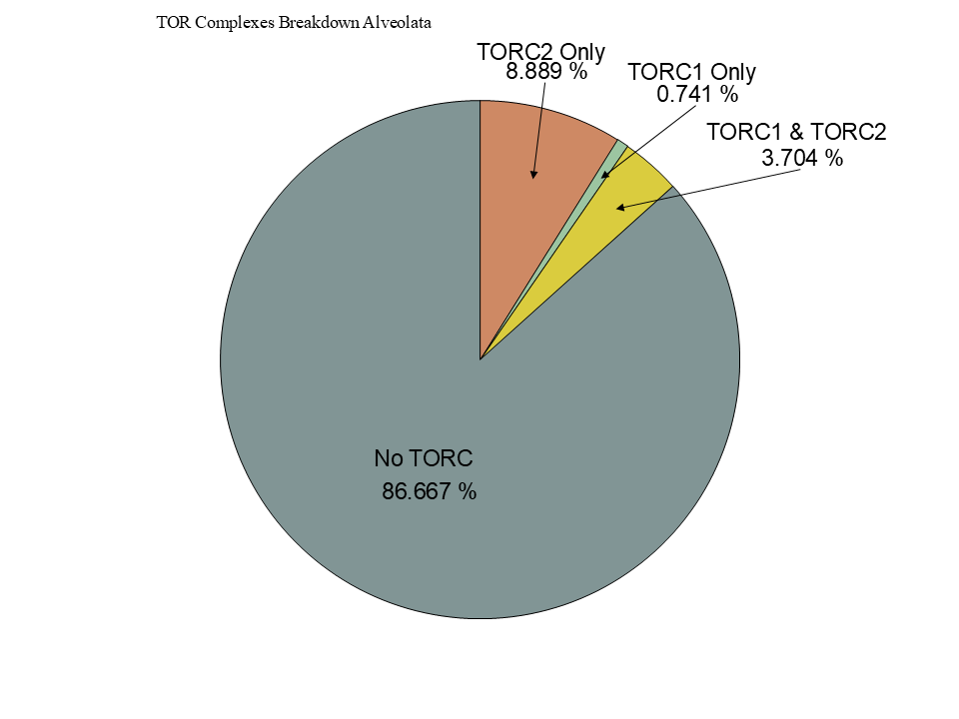
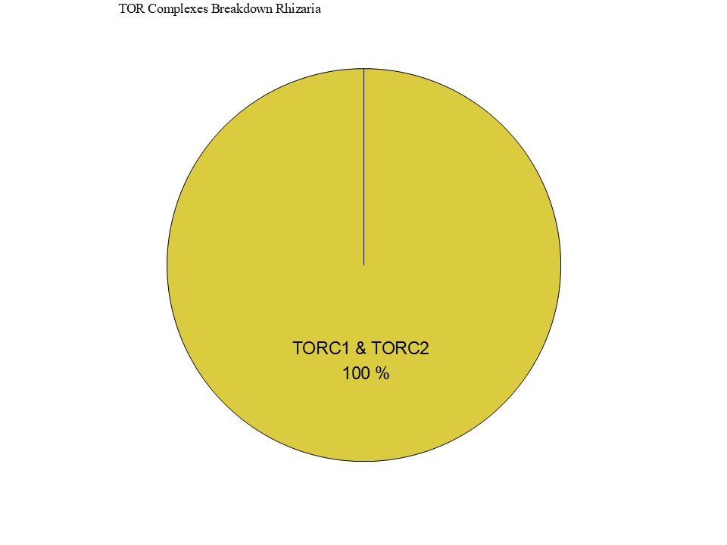
Figure 6

Slide 25
Figure 5

Slide 26










Figure 3
1
1694
RICTORN
RICTORM
RasGEF
Domain5
RICTOR Phosphorylation
ARM Repeats
1
1353
RAPTORN
ARM Repeats
HEAT
ARM Repeats
WD-40 Repeats

Slide 27
Workflow/Pipeline
NCBI/JGI Genomic Information
MSA
Phylogenetic Tree(s)
Results/TOR Complex Patterns
BUSCO/HMMER/BLAST
R Tables & Taxonomy Tables
Graphs/Data Table
SRA /Diamond Alignment
Notes:
We need to add a start point. Have something that asks the question; what organisms have TORC2 Components and TORC1 Components?

Slide 28
SARs Gain of Plastids:
Losses of TOR Complexes
Rhodophyta Endosymbiosis
Phaeodactylum tricornutum
TORC2 Lost
Macrocystis pyrifera
Stramenopila
Nannochloropsis gaditana
Phytophthora sojae
Expected Heterotrophic Ancestor
TORC1 & TORC2 Present
Stramenopile Endosymbiosis
Polarella glaciallis
Vitrella Brassicaformis
Alveolata
Plasmodium falciparum
Tetrahymena thermophila
Alpha-Cyanobacteria Endosymbiosis
Photoautorophy Loss
Paulinella micropora
TORC1 and TORC2 Lost
Bigelowiella natans
TORC1 Lost
Rhizaria
Chlorophyta Endosymbiosis
Plasmodiophora brassicae

Slide 29
Figure 4

Slide 30
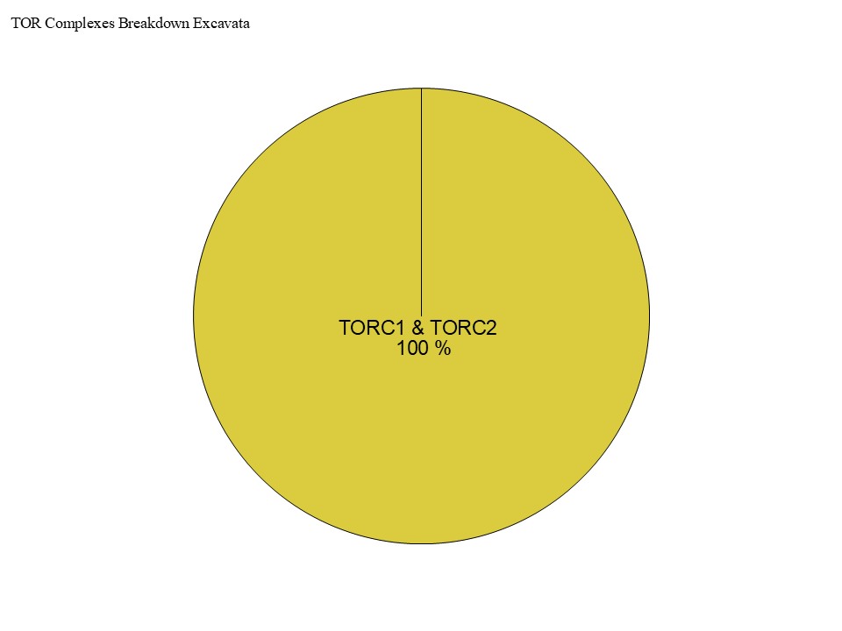
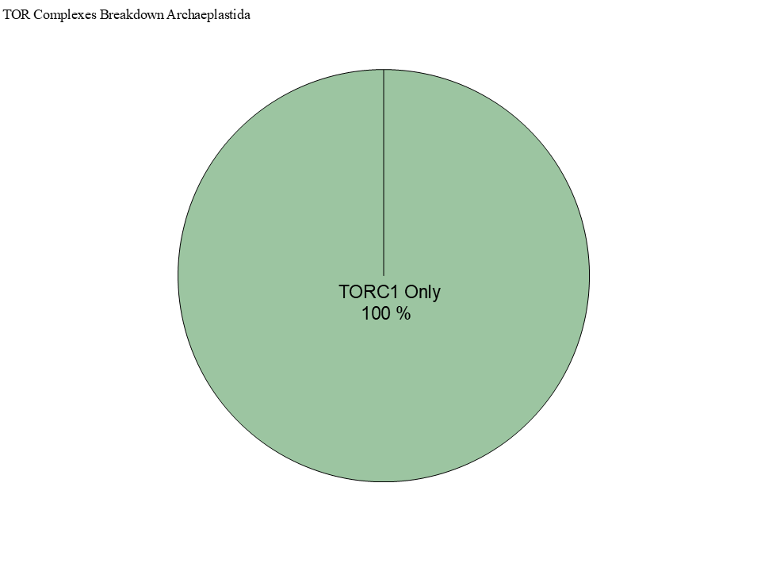
Figure 4

Slide 31
Simplified Excavata Gain of Plastids
Chlorophyta Endosymbiosis
Euglenophyceae
Discoba
Kinetoplastea
Eutetramitia, etc.
Expected Heterotrophic Ancestor
TORC1 & TORC2 Present
Metamonada

